Slide 1
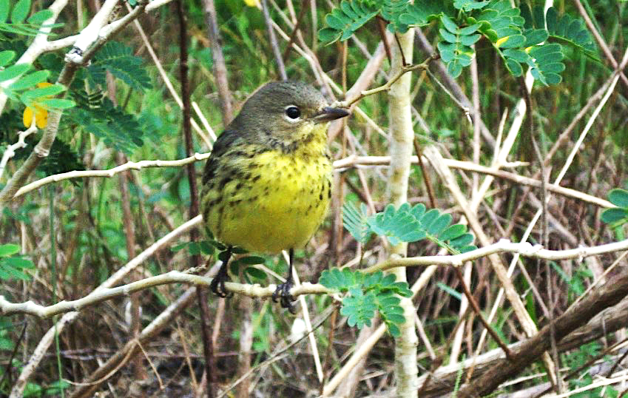
Restore Habitats, Restore Birds: Native Plants for a Bird-Friendly Yard
Notes:
This powerpoint was prepared by Scott Johnson (Bahamas National Trust) and Lisa Sorenson (BirdsCaribbean) for 2015 International Migratory Bird Day celebrations in the Caribbean. The presentation was originally given as a webinar on September 29, 2015. it has been adapted to a presentation, with information included from the guest panelists on the webinar, Dr. Joe Wunderle and Mr. Pericles Maillis. The webinar is available for viewing on Youtube (search for BirdsCaribbean channel).
The first part of the presentation gives an introduction to bird migration and the many challenges and threats that birds face on migration. The second part of the presentation talks about what birds need to survive—food, water and shelter (habitat)— and how we can help birds by planting plants that are valuable to birds, providing a source of water, restoring habitats in our communities, and more. The third part of the presentation gives information on 10 plants that are great for both migrant and resident birds and gives you some tips on how to get started with planting a bird-friendly yard.
Feel free to modify this presentation to suit your needs, for example adding local photos and examples is always great if they are available. You can also make the presentation shorter or simplify it if you are talking to children.
Any questions, don’t hesitate to contact us!
Scott Johnson - sjohnson@bnt.bs
Lisa Sorenson - Lsoren@bu.edu
www.BirdsCaribbean.org

Slide 2
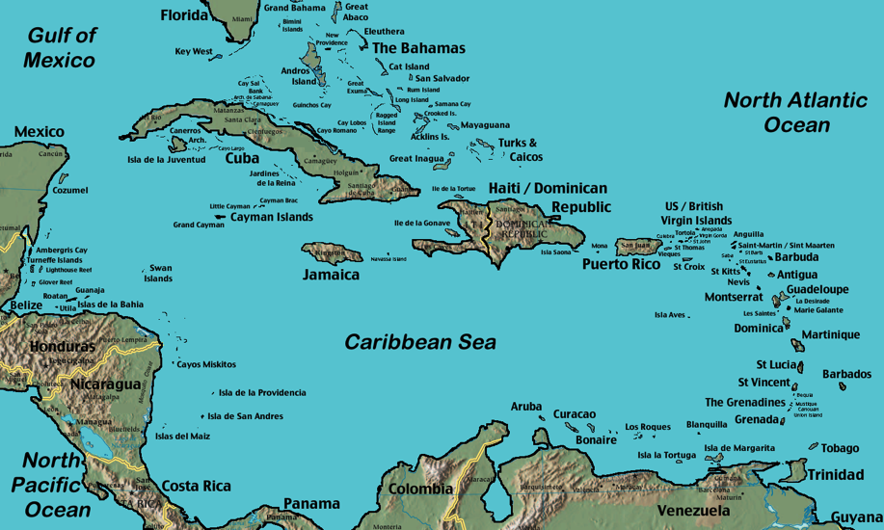
The Caribbean
Notes:
The Caribbean is a rich and diverse archipelago, teaming with an array of different cultures, languages, and habitats. It is divided into three main sections: the Bahamas archipelago, the Greater Antilles, which includes Cuba, Hispaniola (Haiti & Dominican Republic) and Puerto Rico and the Lesser Antilles, which includes the smaller islands arcing south.

Slide 3
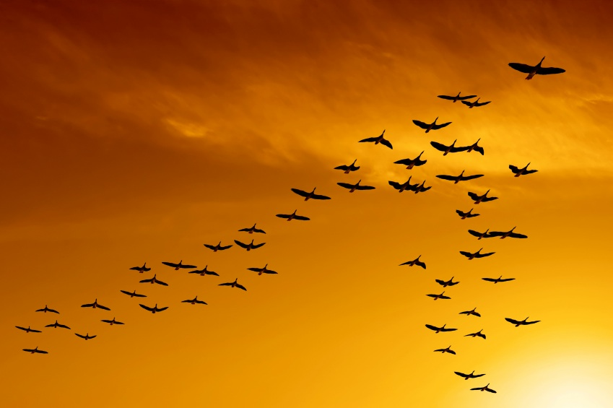
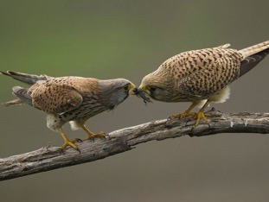
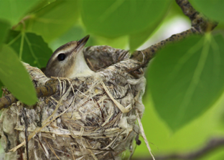
What is Bird Migration?
The seasonal movement of birds from one geographic area to another.
Fly hundreds to thousands of miles a year
Three Types
Short, medium and long distance
Summer migrants
Winter migrants
Reasons for migration
Food
Nesting
Notes:
What is bird migration? It’s the seasonal movement of birds from one geographic area to another. Some birds fly thousands of miles every year to reach areas necessary for it to survive. A good example is the Artic Tern, a bird that flies over 30,000 miles every year! This champion migrant breeds in the Arctic and flies all the way to the Antarctic to spend the winter.
Three types of migrations: Short, Medium & Long distances
In the Caribbean we have 2 migrations:
Summer migrants – Birds that fly north in the Spring months
Northern migrants – those that fly south in the Fall months
Right now we are in the Fall migration period.
There are two main reasons for Migration. One is food. When the seasons change in the cold north, food can become scarce and if the birds did not move to another location they may starve to death.
Another reason is to produce offspring. Baby birds require lots of food for development, so parents usually lay eggs during the time of the year and locations where food is readily available. This is usually during the spring and summer months. After the winter frost thaws, fresh new leaves begin to grow and insect activity increases dramatically… the abundance of food provides the energy that is needed for female birds to lay eggs and raise chicks.

Slide 4
Prepping for Migration
Seasonal / Temperature changes
Hormonal changes
Feeding increase and fat storage
Molt
Notes:
Two things happen when birds prepare for migration:
There is a hormonal change where they start to eat a lot more food & build up more fat around their eyes & breasts that prepares them for the migration.
Many birds also go through a molting period where they change their feathers during this process

Slide 5
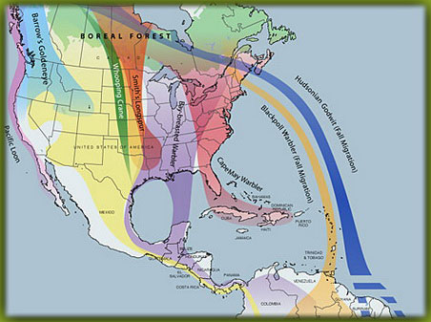
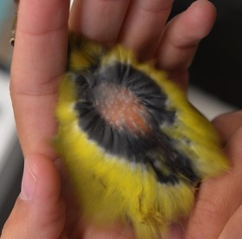
Migrant Adaptations
Internal navigational system and redundancy “equipment”
Internal “map”
Fat: Good fuel source
Notes:
Migrants are amazing in their ability to travel such long distances to the same region every year. Many of them have such keen navigational ability that they can even find the same location they were in the previous year. How do they do this?
Many birds have an internal navigational system with a built in “redundancy equipment” as a backup in case one method does not work. They usually fly at night and use the earth’s navigational field to assist them on their migration as well as the stars and the sun.
They also have an internal map system & many species of birds are “site faithful”, meaning they return to the same spot every year. Their internal map system helps them do this.
You need a huge amount of energy to make such long journeys. Birds store this energy as fat and their fat stores can be so great, that it can make up as much as 55% of a migrants body mass. Fat can be stored in various locations on a bird, including under the eyes.

Slide 6
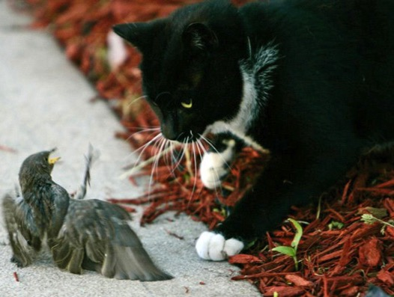
Migration Dangers
Notes:
While birds are migrating, they encounter many dangers.
The migration period is not a safe time for birds and one of the biggest dangers to migratory birds are predators.
Cats for example are big predators of birds & they kill millions of birds every year.

Slide 7
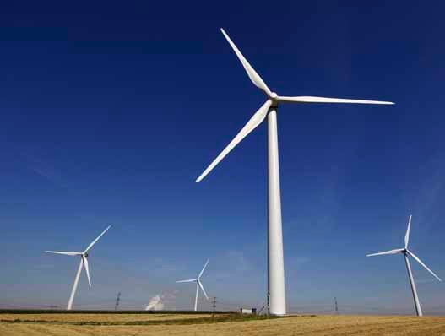
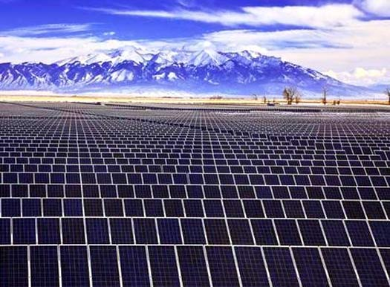
Migration Dangers
Notes:
Another danger to birds is from green energy.
Solar panels & wind turbines / windmills kills tens of thousands of birds every year. As they are flying through they can hit the windmills & when flying over the solar panels it can become so hot that the birds can combust.

Slide 8
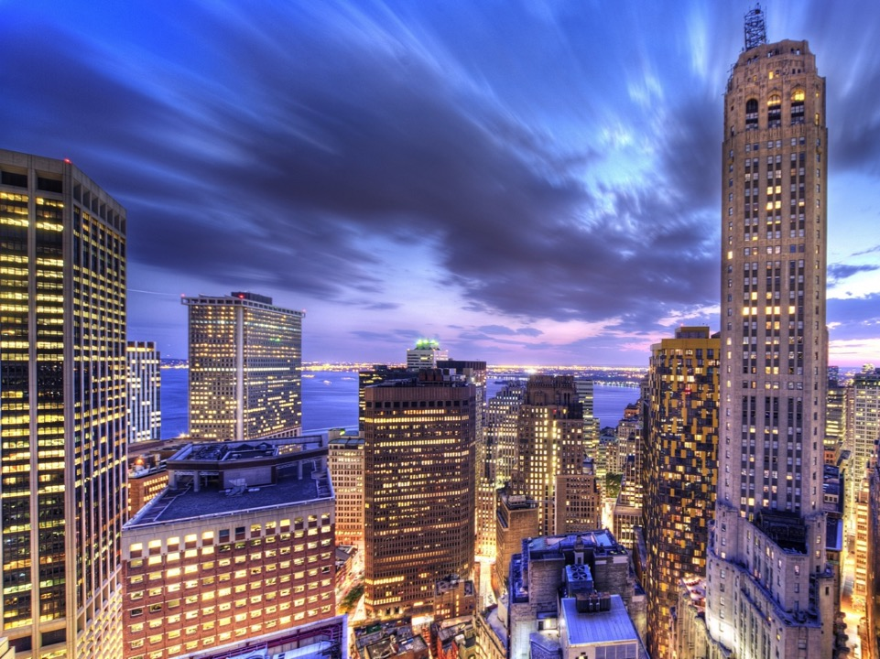
Migration Dangers
Notes:
Birds also collide with buildings, sky scrapers and windows.

Slide 9
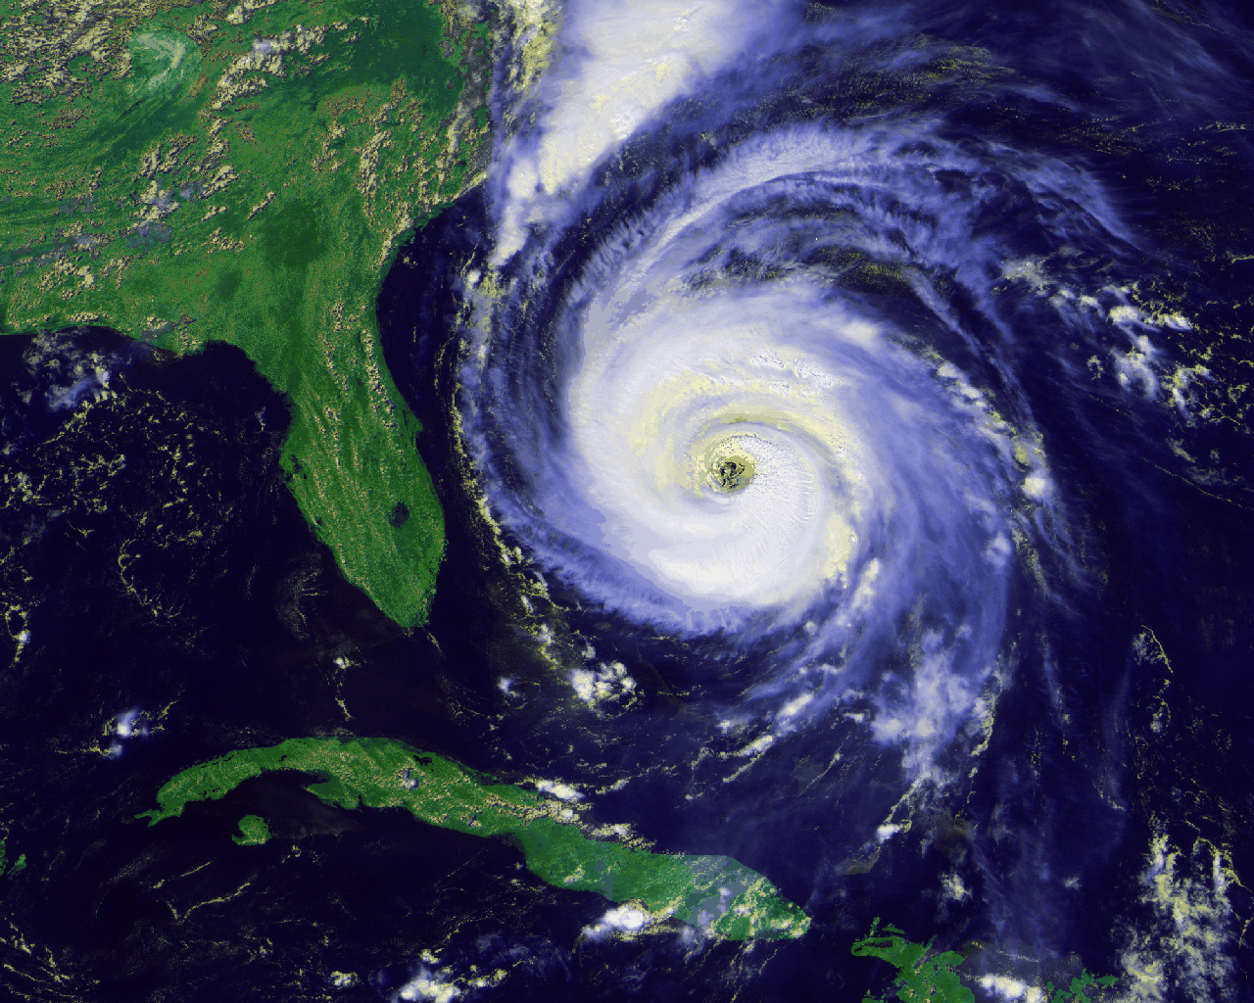
Migration Dangers
Notes:
Storms – As they are migrating south they can run into a hurricane & be killed or lose their vital food sources or the wind can push them into a different direction

Slide 10
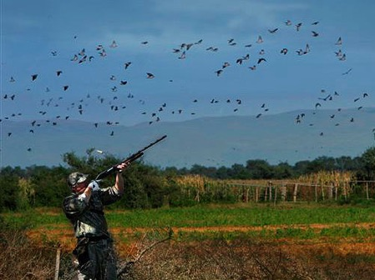
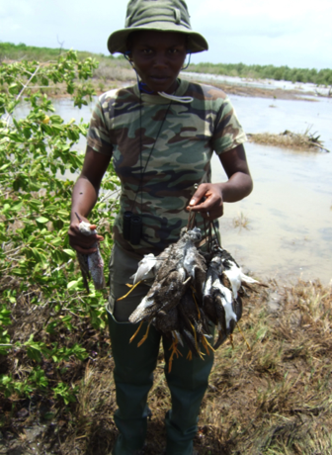
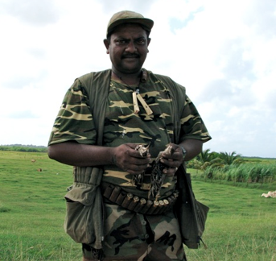
Migration Dangers
Notes:
Hunting – During this time, many hunters are out hunting birds & they become victims to hunters.

Slide 11
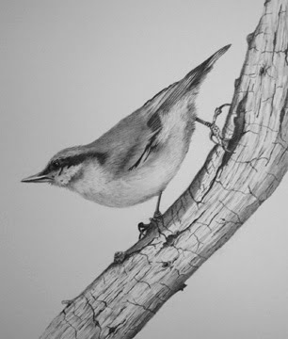
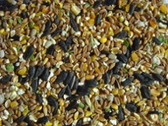
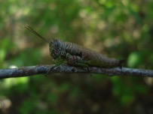
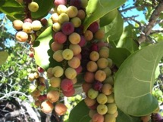
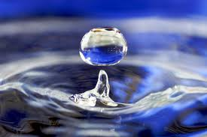
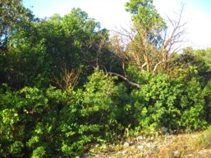
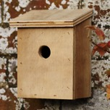
Basic Bird Needs
Food
Water
Shelter
Notes:
All animals have basic needs.
With birds it is no different, they need: 1. Food, 2. Water & 3. Shelter
Birds can find all these basic needs in the habitat they live in.
The best shelter for birds is habitat with a lot of native trees and shrubs which provide the best food and shelter for birds.

Slide 12
What is a habitat?
An environmental or ecological area that is home to a particular organism.
Natural area where a species lives
Physical area surrounding a particular population
Notes:
A habitat is an environmental or ecological area that is home to a particular organism.
It is also a natural area where a species live and
The physical area surrounding a particular population

Slide 13
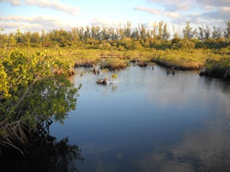
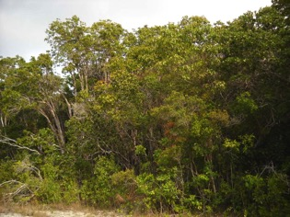
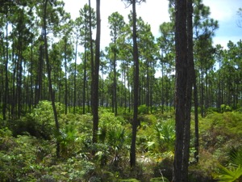
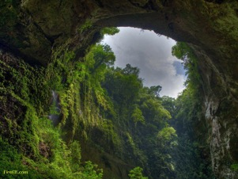
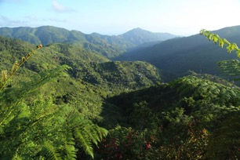
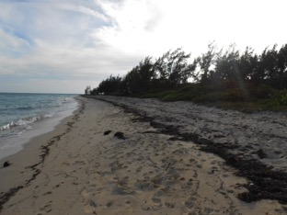
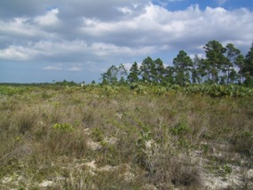
Caribbean Habitats
Wetlands/Mangroves
Pine Woodlands
Dry forests
Rainforests
Mountains
Sea shores/ mudflats
Scrublands
Notes:
In the Caribbean, we have numerous habitats that are able to support a myriad of wildlife.
We have pine woodland areas, wetlands / mangroves, dry forests, seashore & mudflats, rainforests, mountainous regions & scrublands.

Slide 14
Environmental Problems
Less rain
Soil erosion
Invasive species heyday
Global Warming
Pollution
Notes:
A lot of environmental problems can occur with the loss of habitat.
Less rain - Many people do not realize it, but with the loss of trees, there is a loss of rain. Trees take up lots of water in their roots and release most of it through their leaves. The water vapor they release helps it to rain. The removal of trees lowers the amount of evapotranspiration that can occur which can lead to a warmer, drier climate. In many Caribbean countries, water is a problem, especially during the dry season, forcing some governments to ration the water throughout the day. The last thing we need is a drier climate. Unfortunately, climate models predict that we will have more severe droughts in the Caribbean under climate change.
Soil erosion - With the lack of trees to hold the soil together, soil erosion becomes a problem that can lead to mud slides and loss of nutrients to the soil.
Invasive species – When native trees are lost, you actually open up the door for invasive non native plants to establish themselves in a habitat. They can take over, radically transforming the habitat. The end result of habitat loss can be poverty in some places as loss of trees and soil means a loss of agriculture and with the influx on invasive plants and animals, like mosquitoes, disease wouldn’t be too far off.
Global warming – as mentioned above, climate models predict increased summer drying and drought for the Caribbean, which will lead to more forest fires and loss of wetland habitats from drying.
Pollution – Throwing out garbage in various locations instead of where they are suppose to be can cause major havoc to birds.

Slide 15
How can we help?
Notes:
How Can We Help?
There are many ways that we can provide help to migrating birds in the Caribbean.

Slide 16
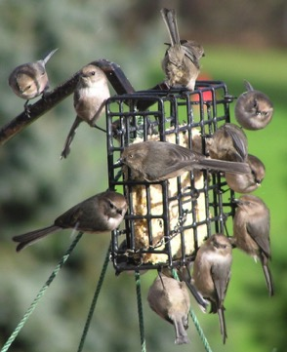
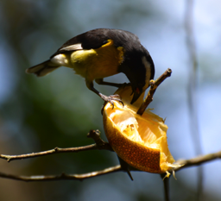
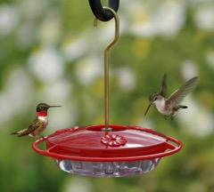
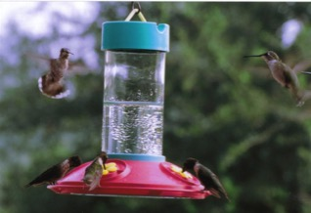
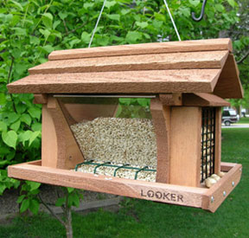
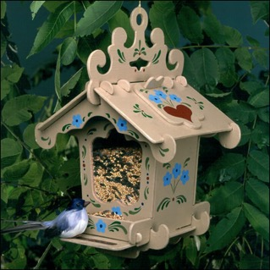
Provide food
Notes:
Provide food – One of the ways is to provide food & set-up bird feeders in your yard– provide seeds, nectar and fruit. This helps birds obtain some food while travelling to gain some energy to continue their trip down south.
And if you plant native plants, these will attract insects that birds like to feed on.

Slide 17
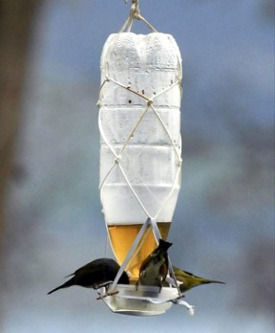
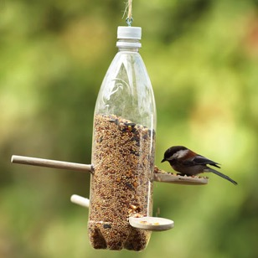
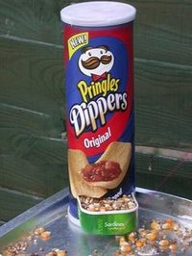
Be Creative!!
Notes:
Be Creative! – You can also be very creative in making a very nice birdfeeder using simple household products.

Slide 18
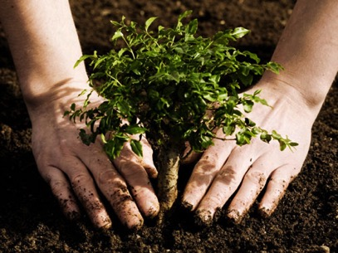
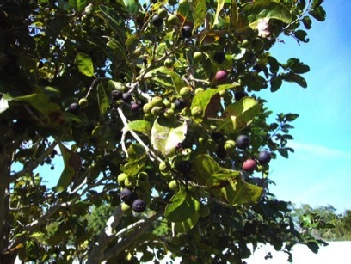
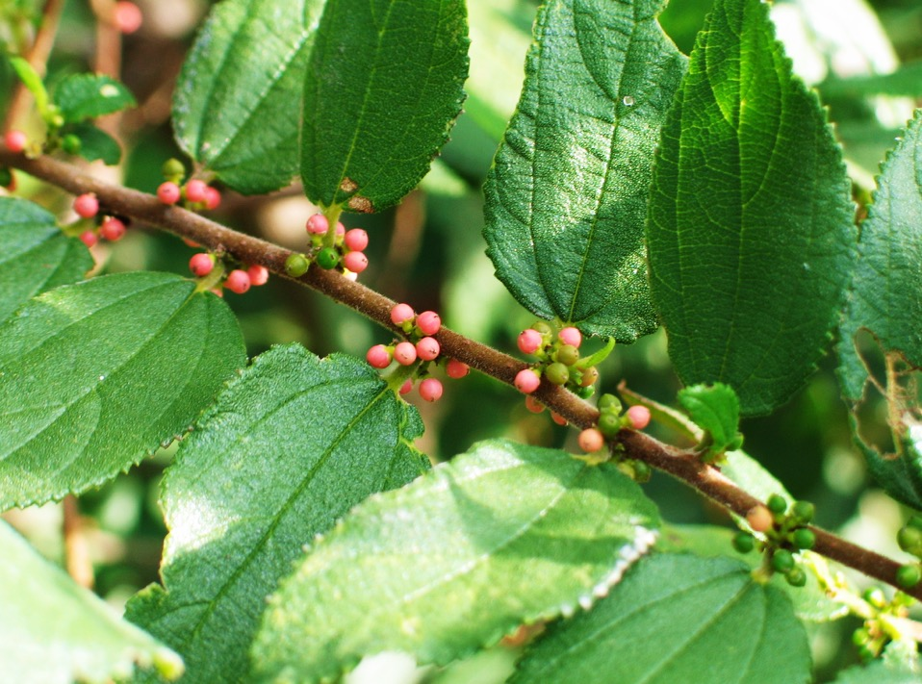
Plant bird-friendly native trees and plants
Trema lamarckianum
Notes:
Plant bird-friendly native trees and plants in your yard - those that provide food for birds (nectar, fruit and seeds), including trees, shrubs, grasses, flowering plant. Often these plants are good for people too - they provide shade and fruit to eat (e.g., coco plum, Barbados Cherry, Mulberry, Seagrape), they are useful in bush medicine, etc.
More details on specific native plants are in later slides in the presentation.
Trema lamarckianum (West Indian Nettle Tree) – warblers love to eat this red berry

Slide 19
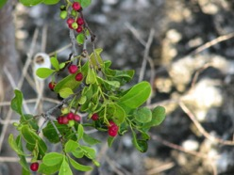
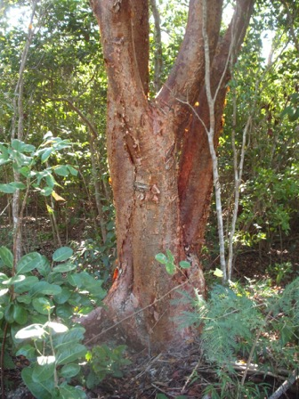
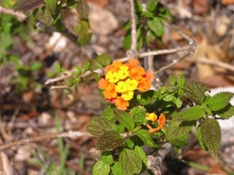
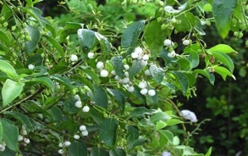
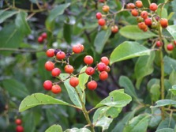
Plant Native
Long-leaf Blolly
Sea Grape
Gumelemi
Bahama Sage
Snowberry
Strong Back
Notes:
These are some examples of native plants that birds use in the Caribbean can also be used in human consumption.

Slide 20
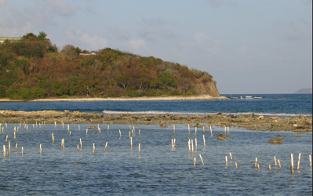
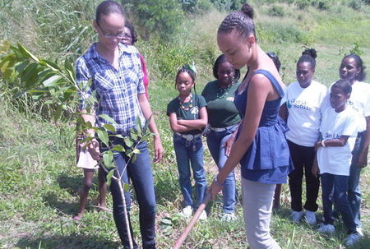
Organize tree plantings
Mangrove replantings
Notes:
Organizing tree plantings is a great way to build social relationships & build a community to assist native birds. Consider planting trees in schoolyards and parks. You add biodiversity to the habitat when you plant a lot of native plants; which increases bird diversity and making the habitat healthier than it is.
Educate youth about native plants that are valuable for birds and people through a school project. Have each child research suggested plants and become on expert on one plant. Get nurseries to donate plants in the beautification project. Especially good to plant trees that produce fruit that kids love to eat!

Slide 21
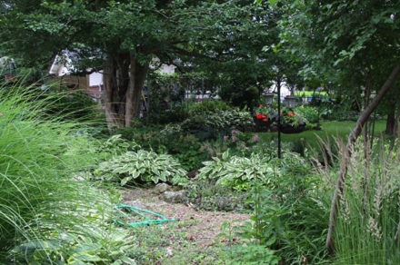
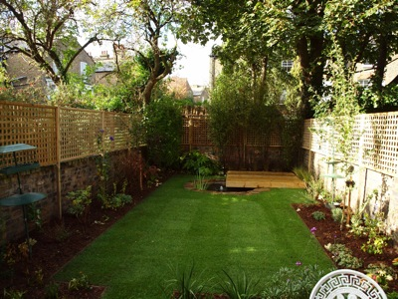
Transform your yard
Notes:
Your yard is also an important habitat for many species of birds. You can enhance your yard not only by planting trees, but by adding flowering shrubs and vines and using leaves and plant debris for mulch. By doing this, you can increase bird diversity in your yard. The work can be hard and tedious, but the end result is a beautiful and eclectic yard that provides for many of the needs of many species of birds.
Share information about the importance of using native plants that are good for wildlife (birds, butterflies, etc) with your friends and family and ask your local nursery to carry native plants that are good for birds and wildlife.

Slide 22
Gardens
Notes:
You can also add gardens to your yard to increase the beauty & diversity of birds.

Slide 23
nwf.org/how-to-help/garden-for-wildlife.aspx
Notes:
There are great resources online to help you to create a backyard that provides habitat to birds, butterflies and other wildlife, for example National Wildlife Federation’s website has many tips for how to transform your yard.

Slide 24
Provide a water source
Notes:
Provide a water source in your yard for birds to drink and bathe in. As mentioned before, sources of fresh water are often in short supply in many Caribbean countries, particularly during the dry season or severe droughts and birds may have a hard time finding enough water to drink.
Having a small pond in your yard, a bird bath, or simply putting a shallow water dish in your yard will attract birds and help them. Providing a fine spray of water from a hose for a small part of the day for birds to bathe in and drink can really help birds, not to mention the added benefit of being able to enjoy them. But if you have a bird bath, make sure you change the water regularly so that it does not become a mosquito factory.

Slide 25
Remove invasive plants
Notes:
Removing invasive plants from your yard (or a natural area) is helpful as they will crowd out other native species & decrease bird diversity. e.g. casuarinas (Australian Pine), Brazilian pepper trees & malaleuca in the Bahamas – If you remove these species then it will increase biodiversity.
You can also volunteer your time with a local environmental organization to help a project to remove harmful invasive species (those that have been introduced and are ”taking over” the habitat, e.g., casuarina, Brazilian pepper, etc.)

Slide 26
Assist in clean-ups
Notes:
Get involved in restoration projects in your community, for example, a clean-up of a local wetland, beach or other habitat that has been degraded with trash and debris. Removing trash will keep the environment healthy, will increase biodiversity and help the community.

Slide 27
Support Local Environmental Groups
Notes:
Support Local Environmental Groups – One of the biggest ways to help.
There are many great organizations and institutions in the Caribbean that are dedicated to preserving precious habitats and ecosystems – just a few are listed here. By working with them, you help to conserve valuable habitats that many species of endemic birds and other animals need to survive.
Please support local conservation organizations in your area. Remember, support does not always have to be financial. You can volunteer your time to assist in clean-ups and other outreach work that is geared towards raising awareness of the environment.

Slide 28
Native plant experts share their knowledge
Mr. Pericles Maillis, self-taught botanist/ naturalist, Nassau, Bahamas
Dr. Joe Wunderle
US Forest Service, Institute of Tropical Forestry, Puerto Rico
Notes:
Guest panelists: Dr. Joe Wunderle and Mr. Pericles Maillis share their information on native plants for birds.
Dr. Joe Wunderle has spent over 30 years conducting avian field research and teaching throughout the Caribbean, including six years in Grenada and the Grenadines before moving to Puerto Rico. He taught zoology at the university of Puerto Rico for eight years before joining the U.S. Forest Service’s International Institute of Tropical Forestry also in Puerto Rico. His field research focuses on migrant birds and their conservation in the Caribbean, and in the last ten years he has concentrated his field studies in The Bahamas, where he and his cooperators have studied the endangered migrant Kirtland's Warbler and its winter habitat.
Mr. Pericles Maillis combines a distinguished career as a senior lawyer in private practice with a passion for farming, fishing and outdoor pursuits, such as gardening and landscaping with native plants. A seasoned conservationist and past President of the BNT, he is an outspoken advocate of the wise and sustainable use of The Bahamas’ natural resources. He is a self-taught botanist with many years of practical experience and has worked on many research and restoration projects on the Bahamas flora and fauna over the years.

Slide 29
Why do we need to restore and provide backyard habitats for birds?
Before man, migratory and local birds previously had vast forest areas that provided shelter, food and water
Humans have built cities, suburbs and housing developments, often with no trees, and hence no value to birds.
Migratory birds arrive exhausted and need food and water fast! If there is a hurricane coming, they need thickets and shelter.
Northern Mockingbird
Notes:
Pericles’ comments: The thing about the need to restore backyards is to remember that in nature, before man started all of this development & interfered with nature, the migratory birds & your local birds had vast forest areas that provided everything talked about earlier: shelter, food & water. There was food for fruit eaters, insect & nectar eaters.
However we built cities & forever expanded suburbia into natural areas and sometimes it happens overnight and so the birds are coming back to stark desert & desiccated landscapes with housing developments with no trees, so now we are talking about the process of mitigating & ameliorating to make backyards a happy beautiful place again for people as well as for birds.
If we don’t go back into our yards & plant trees for ourselves and for birds, then that part of Earth ceases to be of any value to birdlife & the natural areas may be too far away. Their internal clocks might be so dependent on particular areas, that before they can go and find new areas & habitats they perish of hunger or thirst. Some migratory birds are coming ashore so exhausted literally at the end of their endurance that they need food & water fast! If there is a hurricane coming then they need thickets & shelter.

Slide 30
Why do we need to restore and provide backyard habitats for birds?
It is up to us to make our yards “backyard habitats” – these are vitally important for birds.
Individuals, neighborhoods and town councils need to work together and encourage planting
We will reap the benefits—the joy of having birds in our midst!
Black-billed Parrot
Wendy Lee
Notes:
So anything that we can do to plant the basic needs in areas those human beings are messing up, we should do. So whatever we can do to make our gardens, “backyard habitats” they are called, it is all-important!
A bird is not going to treat your garden as his sole ecosystem but he’s going to go from one tree or garden to another across boundaries & fences. Individually we have to work out, as neighborhoods & town councils to try and make suburbia & urban areas as green as we can. If we do, then we will have the joy of seeing these birds right in our midst. To get poetic, “it is a joy forever!”

Slide 31
Why is it important to use native plants?
They are adapted to the location (e.g., climate, soil conditions, etc.)
Native trees attract native insects, which some birds eat
Many native plants have cultural value for medicinal purposes (bush medicine) and tea
Preserving native plants helps to preserve Caribbean culture
Notes:
The advantage of the native plant is that they are adapted to the location; they are climatically adapted here. So just as in the North, when the winter sets in & the trees shed their leaves and the ground is frozen and it’s a water saving device. Here our native trees are adapted to extreme droughts, extreme periods of flooding & they will shed their leaves at the right time when the ground is so dry that even the rocks don’t have any moisture and they therefore live. It helps you keep them alive without you having to use expensive city water and there are more subtle things as well.
The birds & other organisms are adapted to them so that’s one of the strongest reasons for using native species.
Native trees attract native insects and some of our birds are insect-eaters. Also some of the chemistry in native leaves is fertilizer themselves. The West Indian mahogany tree is an “iron factory”. You can break up the leaves and put it around fruit trees like carambola (star fruit) that have a high need for iron. The poison wood leaves are rich in manganese. So this is a whole area of science that is yet to be fully explored for us layman. You have beauty & trees that have adapted and each time you plant a native tree you will perfectly restore that native earth.
Another reason for using native specifies is maintaining a cultural heritage. Many of these native species were used for medicinal purposes & for teas. A lot of our knowledge of medicinal plants is disappearing. As people move into the suburbs & become more urbanized. The reason for preserving our native species is to preserve our native culture in the Caribbean.

Slide 32
What about planting exotics?
Use caution – some exotics are invasive, meaning that they can take over a habitat and outcompete/displace native plants
Exotics may escape from our yards or gardens and take over an area (e.g., Brazilian Pepper)
Some exotic plants have value for birds and are safe to plant, however, make sure they are not invasive!
Antigua Heather (Russelia equisetiformis)
Aloe (Aloe vera)
Notes:
One of the reasons we want to be careful about exotics, particularly those that are called invasive exotics, that can escape from our yards & gardens & colonize natural habitat. Some of these exotics are very invasive; think about the casuarinas (Australian Pine) for example. They can take over a site such that the site, such that native organisms can’t use the site, native plants can grow underneath a caserina. The same for lucina or jumbee bean, they can take over sites for birds. If we plant them in our garden or they escape from our gardens then they can move into the wild & become a threat.

Slide 33
What are the best all-around native plants for birds?
Bananaquit
Kirtland’s Warbler
Notes:
Joe: It’s difficult to pick a top 10 list of native plants but here is list of plants that not only grow well in the Bahamas but also grow well in the Caribbean. I’ve focused in the Western Caribbean primarily on the coastal plain.

Slide 34
Bursera simaruba
Gumbo Limbo, West Indian Birch,
Gumelemi, Almácigo
Notes:
Gumbo Limbo / cumalamy (as known in the Bahamas) / West Indian Birch:
Has a Distinctive reddish bark & bears fruit. In the height of a drought it will lose it’s leaves but maintain its fruits that birds can feed on.
In fact, species such as White-eyed Vireo will set up territories & defend the fruit throughout the winter. Resident birds feed on them, pigeons love them and the fruits last throughout the winter & into the spring, so they are available for quite a long time. They do well in dry areas, so it is definitely a tree that you may want to consider.

Slide 35
Lysiloma latisiliquum Wild Tamarind
Notes:
Wild Tamarind Tree:
Another favorite of mine is the Wild Tamarind tree; this is not the introduced tamarind. There are two members of the genus, the Bahamas.
One of the reasons I recommend this tree is that it attracts a lot of insects & spiders and will produce fresh leaves with the earliest rains, at the end of the winter and at the end of spring.
It’s the flushing of the leaves that also flushes the insects. We’ve seen a number of migrants, with our studies in the Bahamas that will move from one wild tamarind to the next foraging on those insects. So this is a tree to consider for your yard. It doesn’t get very big, is quite attractive & the flowers will attract bees, butterflies & hummingbirds as well as occasionally warblers.
Very useful tree & the important message here is these trees are very useful to migrant birds when they need high protein.

Slide 36
Ficus citrifolia
Shortleaf Fig
Notes:
Ficus / Short leaf fig
Very important for birds. However I will caution you that their roots will & can damage a foundation, driveways & sidewalks.
Focus on figs that are relatively tame like the short-leaf fig.
Produces a fruit that both residents & migrants will eat. I have even seen Laughing Gulls fly inland to feed on the fruits of this tree.
Very useful tree for birds as it will fruit throughout the year.
You want to have a relatively large yard or garden for this tree.

Slide 37
Pseudophoenix sargentii
Buccaneer or Cherry Palm
Notes:
Buccaneer or Cherry Palm:
A very slow going species & found throughout the Caribbean. A lot of the nurseries carry it.
I am a big fan of palm trees as they do really well after hurricanes. They can virtually lose all their fronds & still recover. They may look awful but will still recover & produce fruit. Quite resilient when it comes to hurricane.
Small palm & grows slowly, it produces fruits that migrant & resident birds feed on.
There are other types of palms if you have a large property. For example, the native Royal Palm can bring a diversity of birds, including migrants, but you need a large area.
The palmettos / small palms should be considered because they all produce fruits.

Slide 38
Chiococca alba
Snowberry
Notes:
Snowberry:
Another favorite of mine is the snowberry. You can see from the picture that it produces a white small fruit.
The nice thing about it is it tends to produce fruit in the early winter & fall, So just as the migrants are coming in, it provides a food source.
It’s very nutritious. We’ve done some studies on the nutritional value & it’s very important for those migrants for storing for the fall migration period.
It tends to be scraggly, it has long runners that you can train on a trellis. You may need to control it or it will run all over the yard.
It’s a very attractive plant to consider and fruits are used by birds.
The flowers are popular with various bee species.

Slide 39
Tetrazygia bicolor
Wild Guava
Notes:
Wild Guava:
It is in the Melastomataceae family & this family is a large family of mostly shrubs or small trees, all produce fruits that are popular with birds including warblers, vireos, orioles & native species (tanagers) will also feed on them.
Also very tasty for humans if you want to make a jam out of them, you can.
Wild Guava is definitely worth considering, as you can grow it in a small yard & you can train / trim it & its’ a very good bird plant.

Slide 40
Hamelia patens
Firebush
Notes:
Firebush:
The firebush is popular with birds for 2 reasons. One reason is it is a flower that’s very popular with hummingbirds, Bananaquits, Cape May warblers & other migrants, important for nectivores.
Also produces fruits that are eaten by a variety of birds, it has a fleshy fruit.
Very popular bush; it’s in the coffee family, this family has a number of shrub species that are very popular with birds
Grows in the Bahamas & throughout the Caribbean & should be easy to find in nurseries.

Slide 41
Chrysobalanus icaco Cocoplum, Icacos
Notes:
Cocoplum:
A very hardy plant; I recommend it if you live along the sea coast because it is very salt tolerant.
It produces relatively large fruits & therefore requires relatively large frugivores such as orioles, thrushes, larger vireos & pigeons.
Grows next to the sea side, very salt resistant & can handle dry conditions; its very tough. It also produces a very thick foliage that allows birds to have hiding spaces & nesting places for the resident species, also places for insectivores to forage.
The Coco plum is a worthy consideration even for the smallest yard.

Slide 42
Erithalus fruticosa
Black Torch
Notes:
Black Torch:
One of my favorites, probably because the bird I study, the migrant Kirtland’s Warbler, feeds heavily on the Black Torch. A variety of other warblers, both native & migrant warblers, feed heavily on the fruits.
The black torch will fruit throughout the year at different times, may have different periods when they have their fruits available, It is also highly salt tolerant & does well in a small or large yard but it is generally a small shrub. I’ve seen a few that have grown up to 15 ft. but usually less than that.
This would make a good addition to a garden for migrant birds.

Slide 43
Lantana involucrata
Wild Sage
Notes:
Wild Sage:
This is a species very popular with birds, both residents & migrants.
A very tough species as it doesn’t need a lot of soil, and it can handle salt spray & droughts.
Produces fruits & flowers throughout the year, in other words, it cycles between flowers and fruits several times of year.
Your garden can have the availability of nectar for hummingbirds from the white flowers & the fruits for the diversity of migrant birds.
It’s a very tough species. Don’t be surprised if these “volunteer” in your garden, that is they are dispersed by birds & grow on their own.

Slide 44
How does one start a native plant garden in their yard?
First, rake your ground and clear the rocks
Dig large holes so the roots can go down, bring in soil and put it into the holes
Think about planting native plants for the birds but also plants that provide foods for your family to eat
Bananas and Key Lime
Pigeon Peas
Brasilita
Notes:
Here in the Bahamas you are starting with stark bare limestone ground, because the developers skim off everything to build your house & leave you with bare ground.
Everybody has the dilemma: We all want a pretty garden but we also want things to eat. And conservationist & environmentalists are saying to plant bush.
My advice to everybody is to start doing something.
Start to rake your ground & clear the rocks, dig holes if your treasury permits it, use a backhoe.
Dig holes down so the roots can go down.
Bring in soil & put it into the pits where you plan to plant your network of trees.
Then if you have family disagreements & people want things to eat as well, try bananas.
Plant some bananas, although they are not native, the Bananaquits & nectar eaters will love them & the plants will harbor lots of insects. If you don’t pick the fruit in time, then the fruit eaters will eat them.
Plant pigeon peas – These are full of flies & insects; which is why they don’t use them for agricultural hedges anymore but are wonderful for birds & put lots of nitrogen into the ground.
If you want fruit trees, plant key lime in the Caribbean, as everybody needs key limes, they are very important for nesting birds Migrant birds may not use it as much but the local ones will.
Brasalita, the one we have here in the Bahamas is heavily laid with thorn & is a snake-resistant tree. Stick one in the ground and you can make tea

Slide 45
Additional plants to consider:
Barbados Cherry Tree – great source of vitamin C for children and they fruit several times a year – birds love them
Sapodilla – will become a big beautiful tree with insects, nectar and fruit for the birds
Mulberries – fruit in the winter when it is famine time for birds, wonderful for children also
Aloes – quick and easy to plant, good for people and birds
Notes:
Barbados Cherry tree – For children, plant Barbados cherries because they not only are wonderful vitamin C for the kids but they fruit several times a year. Birds love them so plant those.
If you have room in your garden, there are tropical fruits that we consider native but not strictly native in the islands, Sapodilla will become a big beautiful tree with insects, nectar & fruit to feed birds.
Mulberries – You catch them from cuttings and they fruit in the winter; which is really famine time for a lot of migrants & natives. Wonderful for children.
Aloe plants – A quick & easy thing for us to plant is aloes, good for people and also birds
So there are things that you can plant that are not only bush, that will take care of that side of the family controversy & then the native trees depends again on treasury, it is very hard in the Caribbean to find a big native tree in a pot to buy so that you can end up with instant landscaping.
In the whole Caribbean basin it is very hard to find big native trees in pots, it is really only the nurseries in Florida that excel at producing large numbers of trees that are native to the Caribbean, especially the Bahamas.
To everyone who is listening, this is part of the future to grow native trees & as we get the spirit of growing native trees there will be tremendous demand for native trees, plants that Joe & I are talking about, people will ask, “where can I get these?”

Slide 46
http://www.birdscaribbean.org/resources/#HeritagePlants
Notes:
We have a free eBook available for download from our website (BirdsCaribbean.org:
http://www.birdscaribbean.org/2015/09/international-migratory-bird-festival-focuses-on-caribbean-habitat-restoration/

Slide 47
Thank You and let’s get to work restoring our yards for our birds!
For more information, visit:
BirdsCaribbean.org
Birdday.org
http://www.levypreserve.org
nwf.org/how-to-help/garden-for-wildlife.aspx
Follow us on Facebook (Caribbean birds), Instagram (BirdsCaribbean) and Twitter (@birdscaribbean)
Email: Info@BirdsCaribbean.org
Notes:
Please Visit our website, sign up for our Yahoo discussion groups, and follow us on Facebook, Instragram and Twitter.
For more information, email us at info@BirdsCaribbean.org

